Slide 1

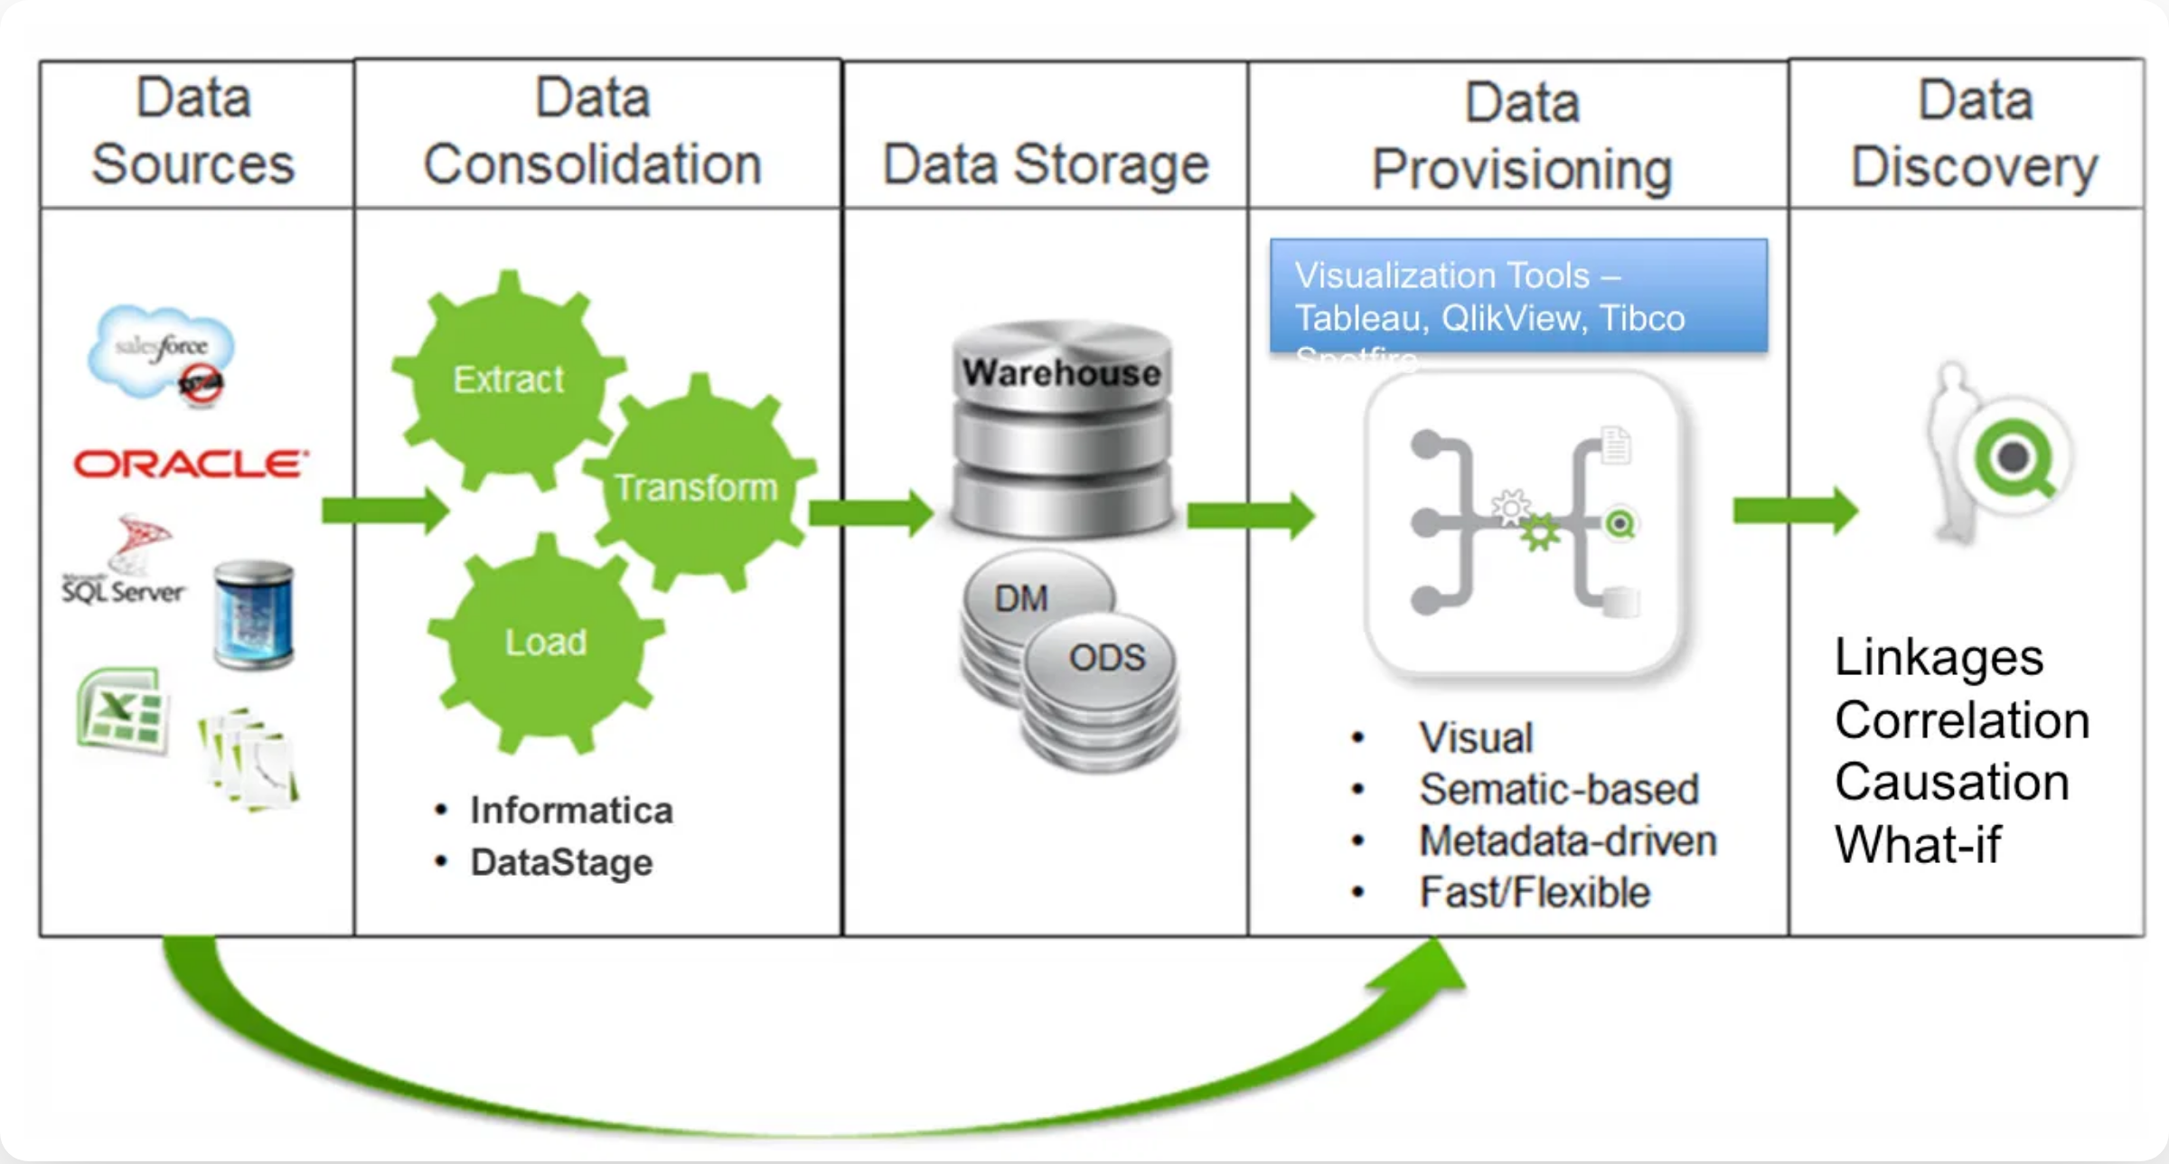
📊 Fundamentals of Data Storage - Files
Data Curation & Visualization Course (DA2402)
Enhanced with Practical Examples and Performance Optimization

Slide 2


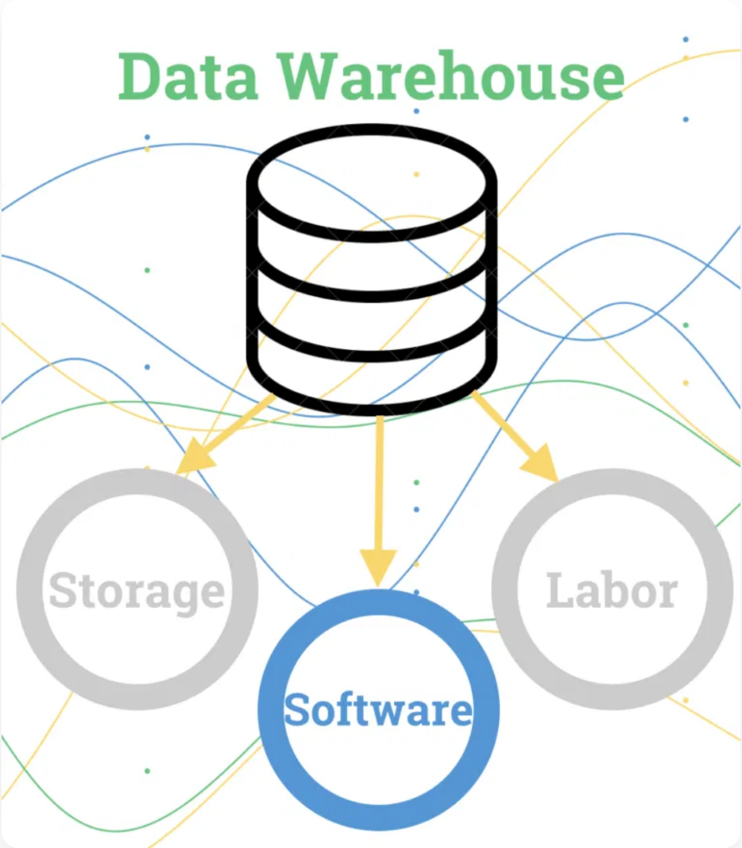
Learning Objectives
Understand the role of data storage in curation
Explore file-based, relational, and indexed storage
Compare tradeoffs of different formats
Optimize data I/O for performance and memory
Hands-on: CSV, Parquet, SQLite with real examples

Slide 3








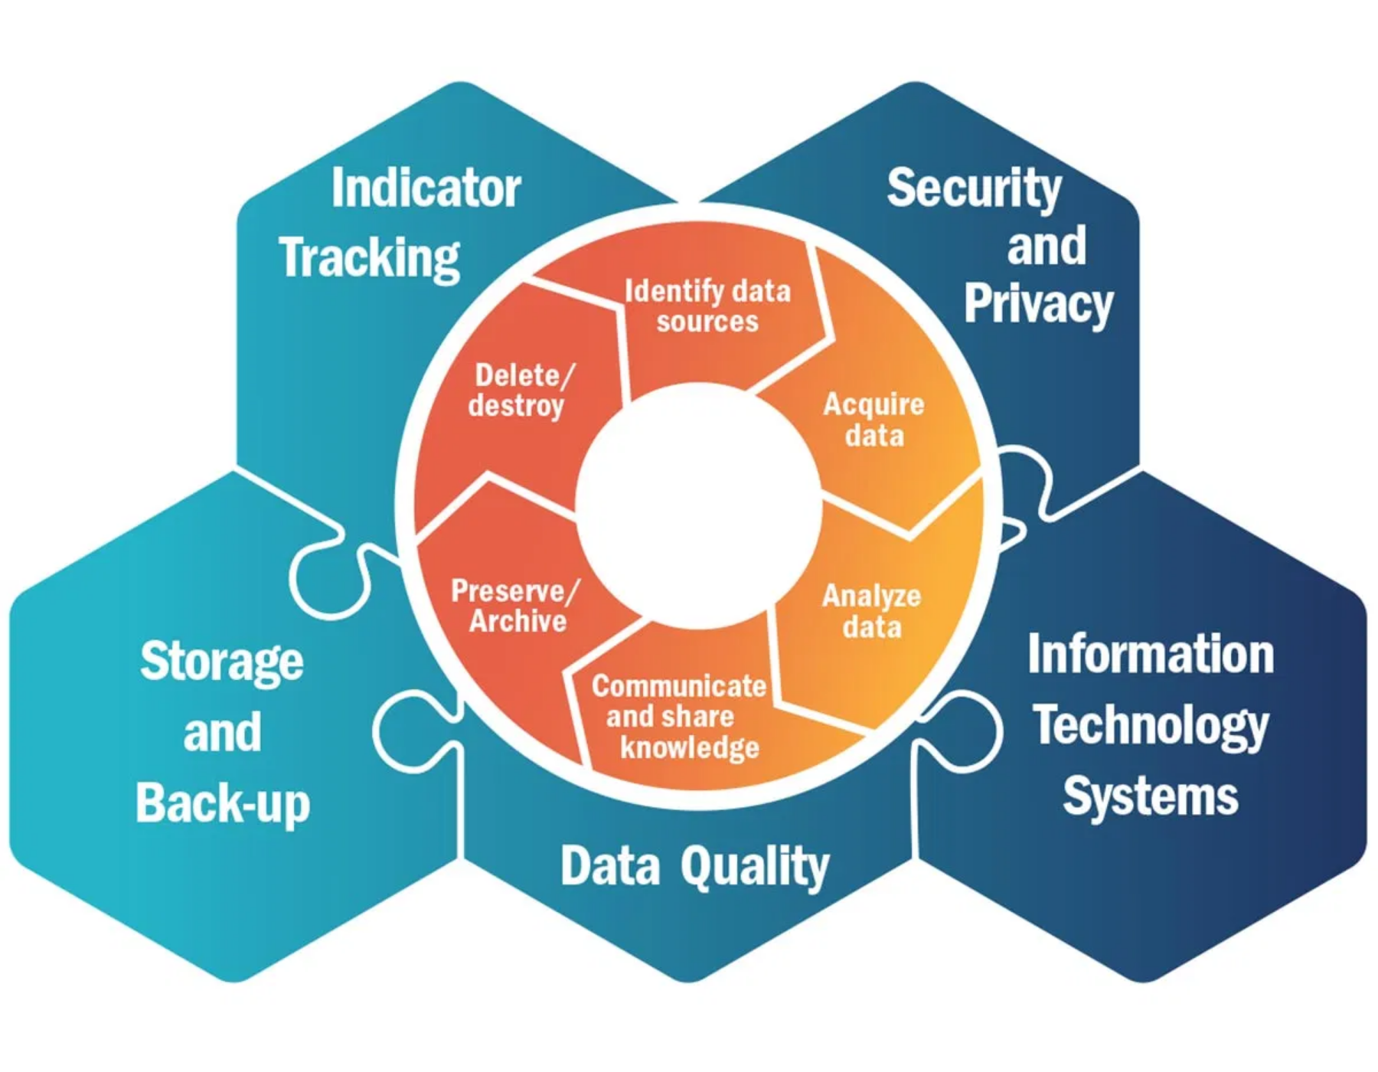





Phase 2: Data Storage
Storage Types and Technologies
Relational DB
NoSQL
Data Lakes
Data Warehouses
Cloud Storage
On-Premises
Structured vs. Unstructured Data
Structured Data
Unstructured Data
Organized in relational databases
Stored in NoSQL or object storage
Fixed schema and format
Flexible schema or no schema
Examples: CRM, ERP data
Examples: emails, documents, media
Security and Encryption
Data encryption (at rest and in transit)
Access controls and authentication
Data Lifecycle Hexagonal Diagram Highlighting Storage Component
Data redundancy and backup
Compliance with privacy regulations
Data Lifecycle Management and Data Governance | Page 9

Slide 4




Why Data Storage Matters
Data curation lifecycle depends on reliable storage
Impacts data quality, access speed, cost
Foundation for cleaning, wrangling, visualization
Real Impact Example
10GB CSV → 3GB Parquet = 70% storage savings + 5x faster queries

Slide 5

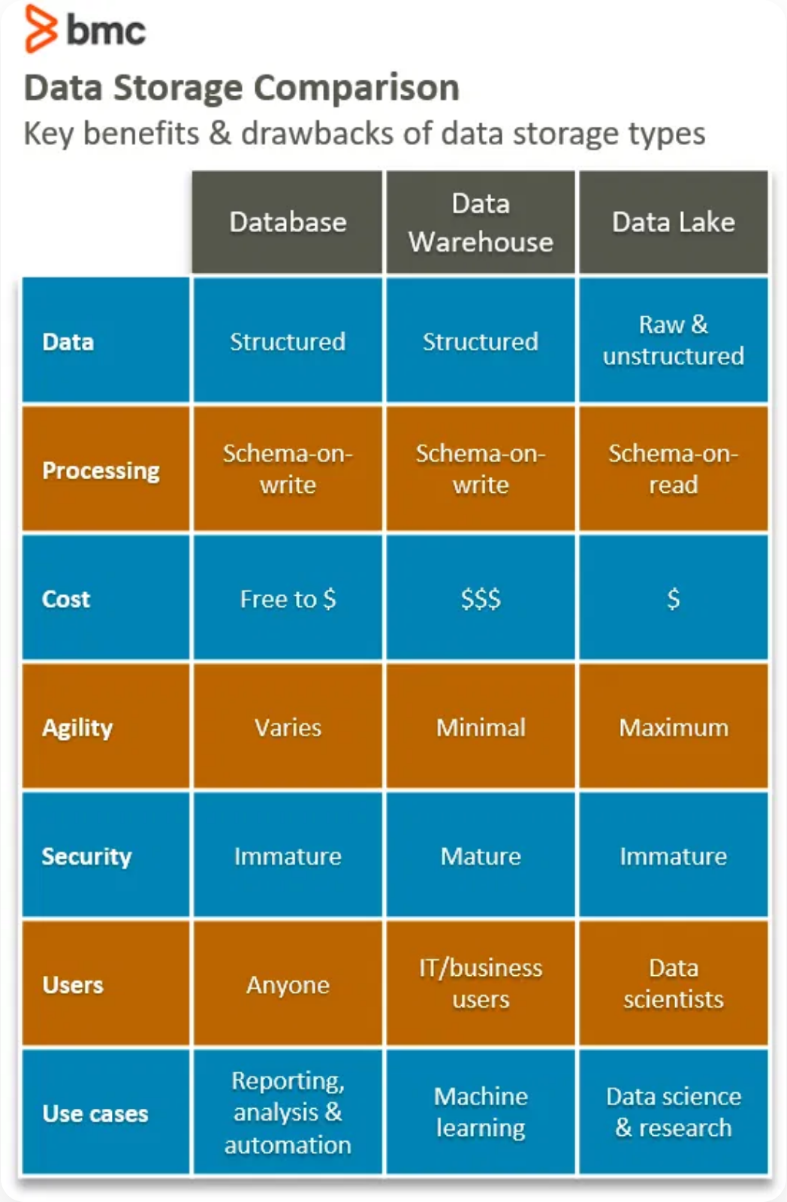



Evolution of Storage
1960s
Flat files
→ early text/CSV
1970s
Databases
→ relational models
2000s
NoSQL
→ flexibility for semi-structured
2010s
Cloud
→ distributed & scalable

Slide 6

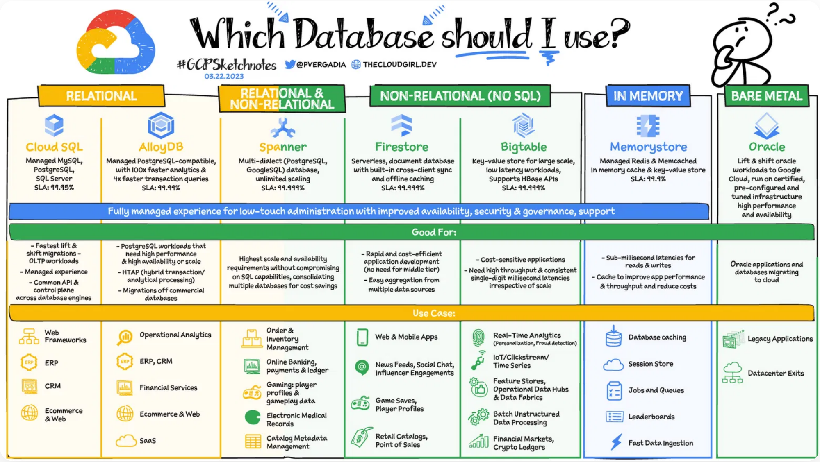
Storage Categories
File-based
(CSV, JSON, Parquet, HDF5)
Relational databases
(SQLite, PostgreSQL)
NoSQL systems
(MongoDB, Redis) -
Cloud & distributed storage
(S3, BigQuery) -

Slide 7


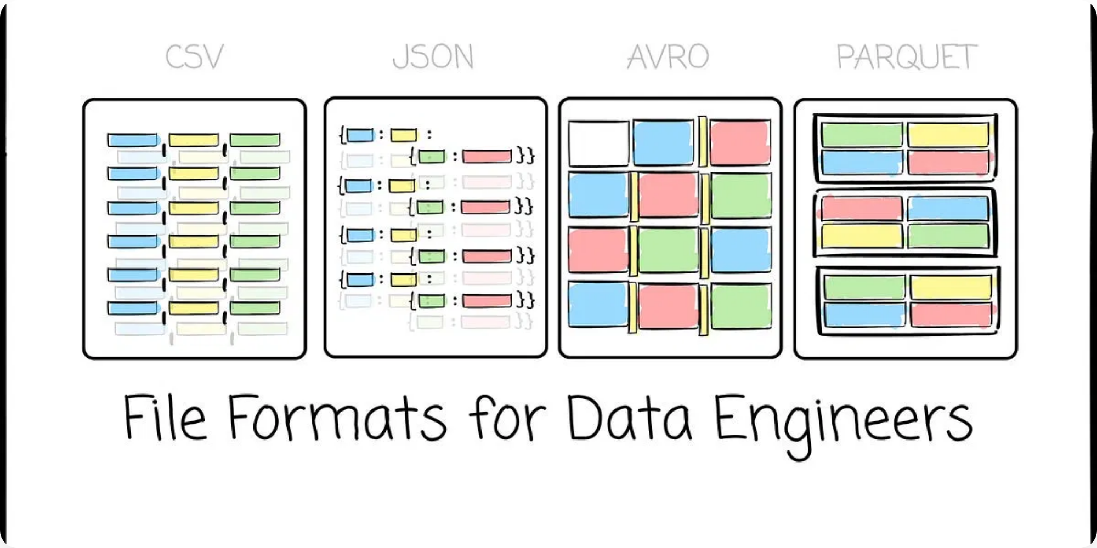
File-based Storage Basics
Common formats:
CSV, JSON, XML, TXT, Parquet, HDF5
✅ Pros
❌ Cons
Easy to create and share
Limited scalability
Version control friendly
No concurrent access control
Simple structure
No built-in data validation
Use cases:
Data exchange, prototyping, small-medium
datasets

Slide 8



CSV (Comma-Separated Values)
Human-readable, widely supported format
✅ Pros
id
name
score
timestamp
Universal compatibility
1
Alice
85.5
2023-01-15 09:30:00
Simple structure
2
Bob
hundred
2023-01-15 10:15:00
Human-readable
3
Charlie
78.5
2023-01-15 11:00:00
❌ Cons
No schema enforcement
Text-only format
Memory inefficient
# Memory optimization for large CSVs
df = pd.read_csv('data.csv',
Encoding issues
dtype={'id': 'int32', 'score': 'float32'},
parse_dates=['timestamp'],
chunksize=10000)
# Process in chunks

Slide 9





CSV Best Practices
Always specify encoding:
encoding='utf-8'
Memory Saving Tip
Using appropriate dtypes can reduce memory usage by up to 70% for large datasets.
Use appropriate data types to save memory
Handle missing values explicitly
For large files: use
chunksize
or
nrows

Slide 10


JSON (JavaScript Object Notation)
Stores hierarchical/semi-structured data, widely used in APIs
✅ Pros
Flexible schema
Nested structures
Human-readable
Web-native format
❌ Cons
Text overhead
Slower parsing
# Handling nested JSON
No compression
import json
Inconsistent schemas
import pandas as pd
# Flatten nested JSON structures
data = pd.json_normalize(json_data, sep='_')

Slide 11
Parquet files
What is Parquet?
Born from Twitter + Cloudera (later Apache project).
Solved: Efficient columnar storage for Hadoop/Spark
Open-source, columnar storage format.
Developed by Apache.
Optimized for analytical queries.
Self-describing → schema embedded.
Efficient compression & encoding
Supports complex nested data
Cross-platform (Hadoop, Spark, Pandas, Arrow)
Row vs Column Storage
Row-based (CSV, JSON): better for transactional data.
Columnar (Parquet): better for aggregations, filtering.
Example: SELECT avg(salary) → Parquet only reads salary column. Parquet uses columnar compression:
Run Length Encoding (RLE)
Dictionary Encoding
Bit Packing
Columns with repeating values → huge savings

Slide 12
Parquet file compression
Codec | Compression Ratio | Speed (Read/Write) | Use Case
Snappy | Medium | Very Fast | Default for analytics
Gzip | High | Slower | Archival, storage
Brotli | Very High | Slowest | Web/archival
LZ4 | Medium-Low | Very Fast | Real-time processing
ZSTD | High | Fast (tunable) | Data lakes, general use
None | N/A | Fastest | Debugging only
# Compression options
df.to_parquet('data.parquet', compression='snappy')
# fast
df.to_parquet('data.parquet', compression='gzip')
# smaller
df.to_parquet('data.parquet', compression='brotli')
# best compression

Slide 13
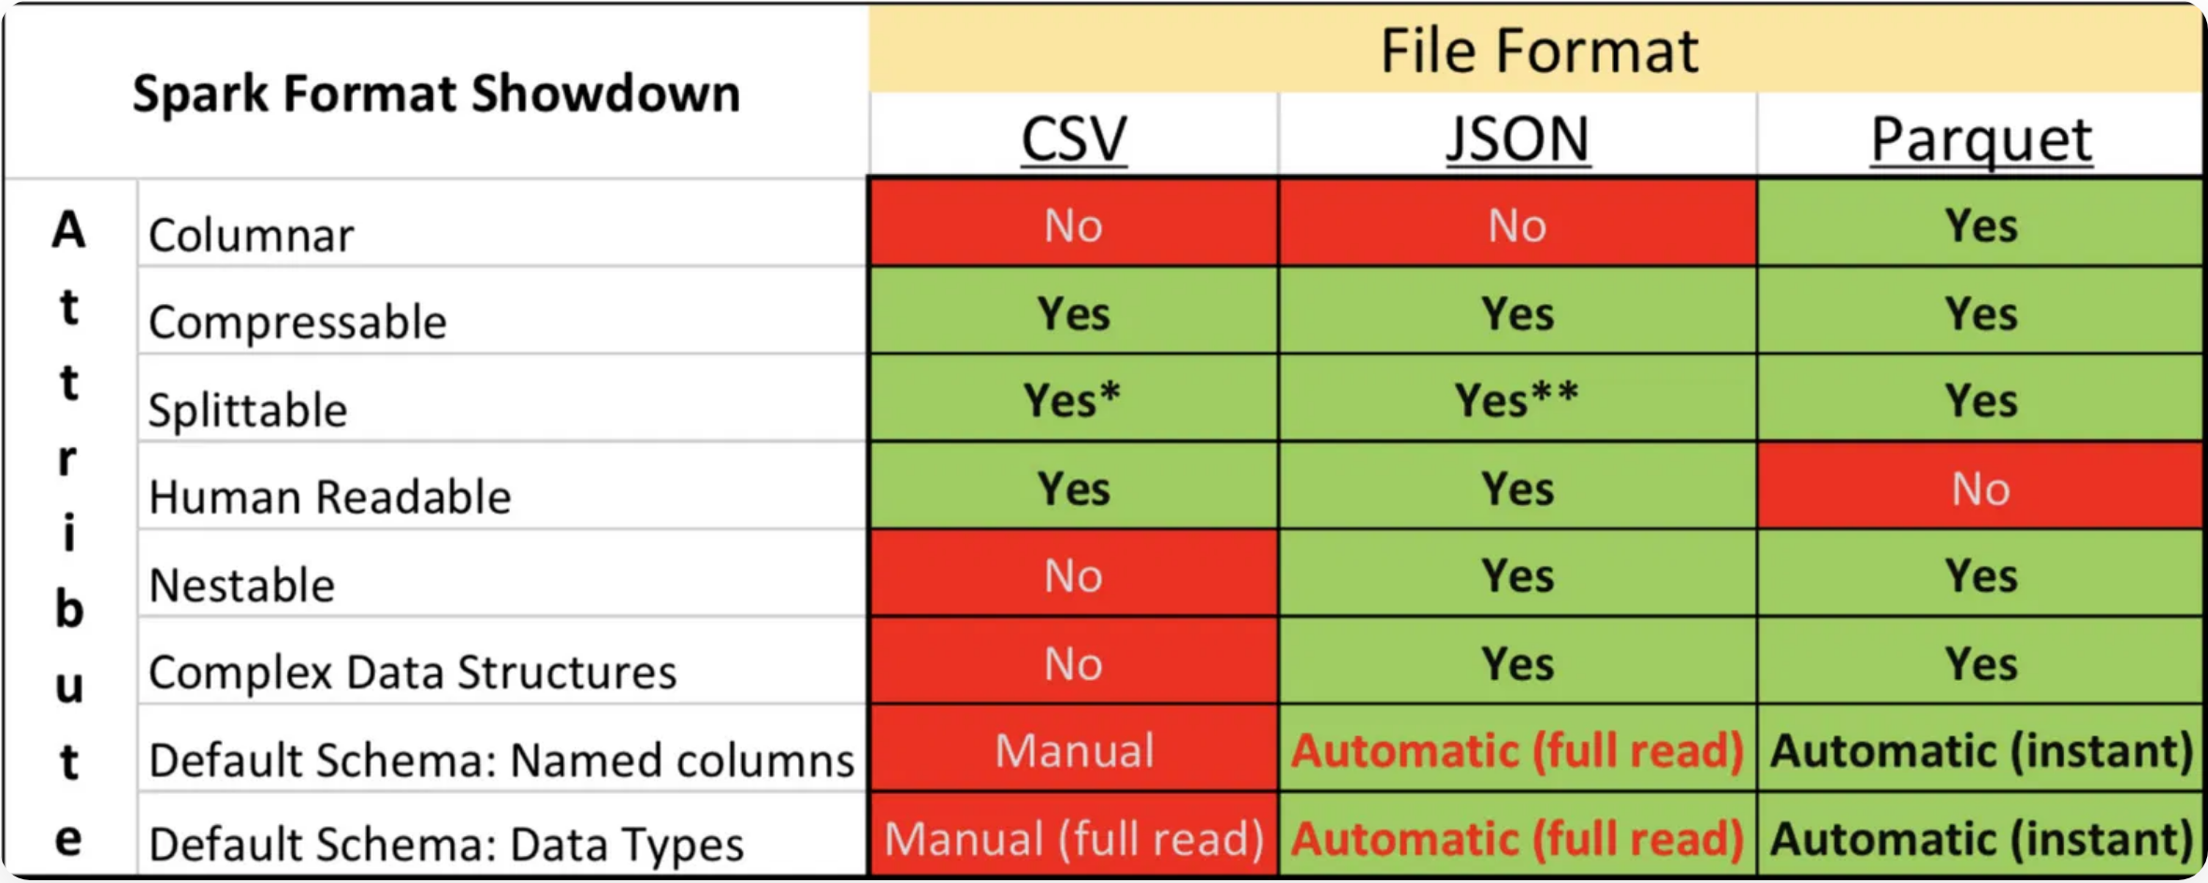







Parquet Format
Columnar binary format optimized for analytics with built-in compression
✅ Pros
Fast queries
Small file size
Schema preservation
Columnar storage
❌ Cons
Not human-readable
Requires specialized tools
Write overhead for small files

Slide 14


Handling Missing Data
Different formats handle missing values differently:
# CSV - string representations
df.to_csv('data.csv', na_rep='NULL')
# Parquet - native null support
df.to_parquet('data.parquet')
# Preserves pd.NA/None
# Handle missing values during read
df = pd.read_csv('data.csv', na_values=['', 'NULL', 'N/A', 'missing'])
Important:
Always specify na_values when reading CSVs to ensure consistent missing data handling across different systems.
Parquet Advantage
CSV Challenge
Preserves native null values and data types, ensuring consistent representation.
Uses string placeholders for nulls, requiring explicit handling during import.

Slide 15

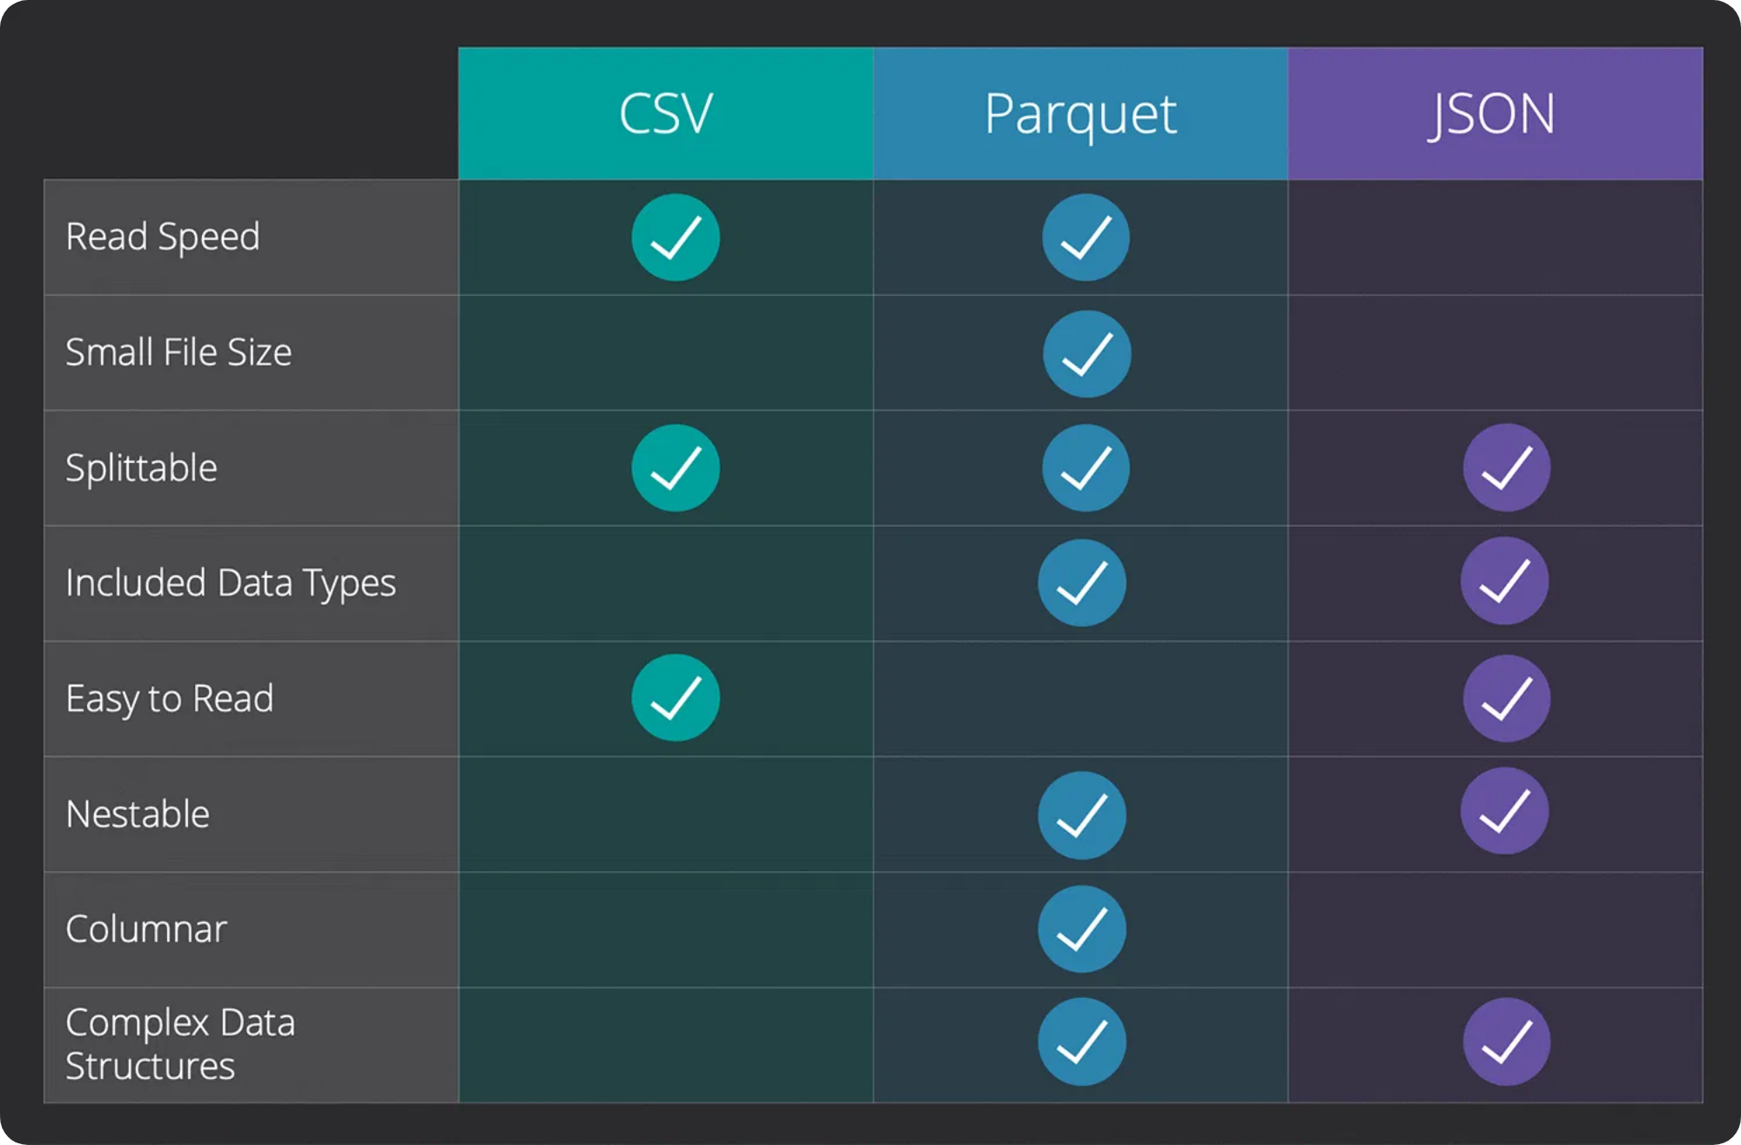
Data Validation & Schema
Format
Schema Support
Type Preservation
Validation
CSV
❌ None
❌ Inferred
Manual
JSON
⚠️ Flexible
⚠️ Inconsistent
JSON Schema
Parquet
✅ Built-in
✅ Preserved
Automatic
# Schema validation
expected_dtypes = {
'id': 'int64',
'name': 'string',
'score': 'float64'
}
df = df.astype(expected_dtypes)
# Parquet preserves schema automatically
Data validation ensures consistency and reliability across different storage formats
df.to_parquet('data.parquet')
df2 = pd.read_parquet('data.parquet')
# Same dtypes!

Slide 16







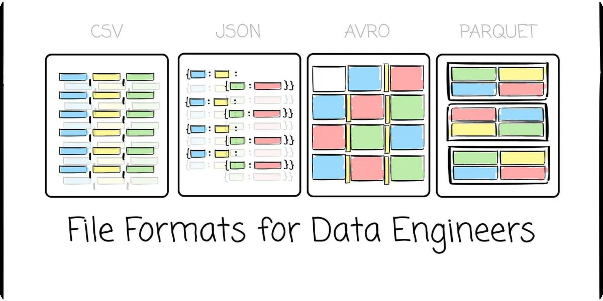
Comparing Formats
Format
File Size
Read Speed
Human-Readable
Schema
Compression
Best Use
CSV
Large
Slow
Data exchange
JSON
Large
Slow
Partial
APIs, nested data
Parquet
Small
Fast
Analytics, storage
HDF5
Small
Fast
Scientific data
🚀 For data analytics workloads, Parquet offers the best balance of performance and storage efficiency

Slide 17





Performance Benchmarking
How to Benchmark Storage Formats
Benchmarking helps quantify the performance differences between storage formats for your specific use case.
Create test dataset
with realistic data types and volume
Measure write time
for each format
Measure read time
for each format
Compare metrics
like file size, memory usage, and query speed
Benchmarking Tip
Run benchmarks multiple times and average the results to account for system variability.
return
save_time, read_time
# Example usage
csv_write =
lambda
: df.to_csv(
'test.csv'
)
csv_read =
lambda
: pd.read_csv(
'test.csv'
)
parquet_write =
lambda
: df.to_parquet(
'test.parquet'
)
parquet_read =
lambda
: pd.read_parquet(
'test.parquet'
)
csv_times = benchmark_format(df,
'CSV'
, csv_write, csv_read)
parquet_times = benchmark_format(df,
'Parquet'
, parquet_write, parquet_read)

Slide 18

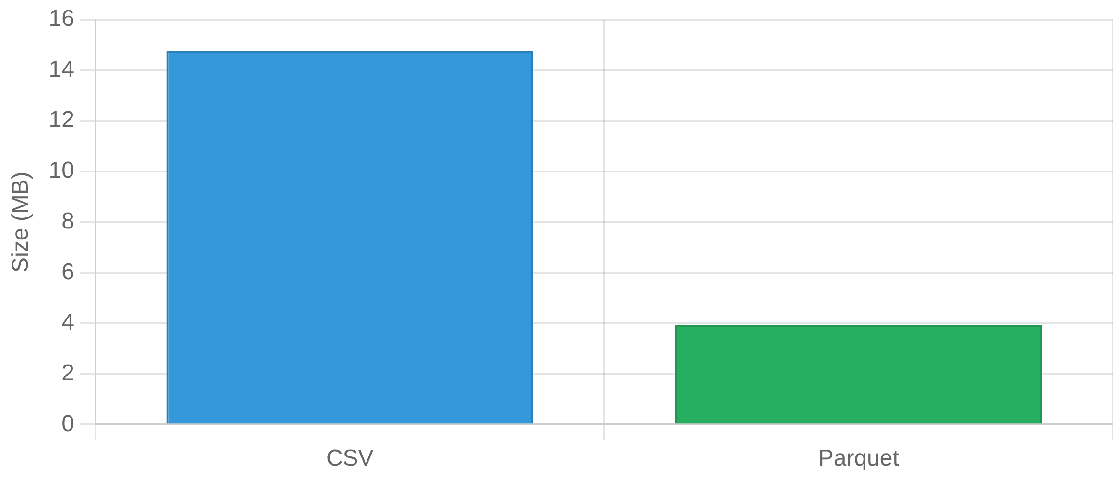
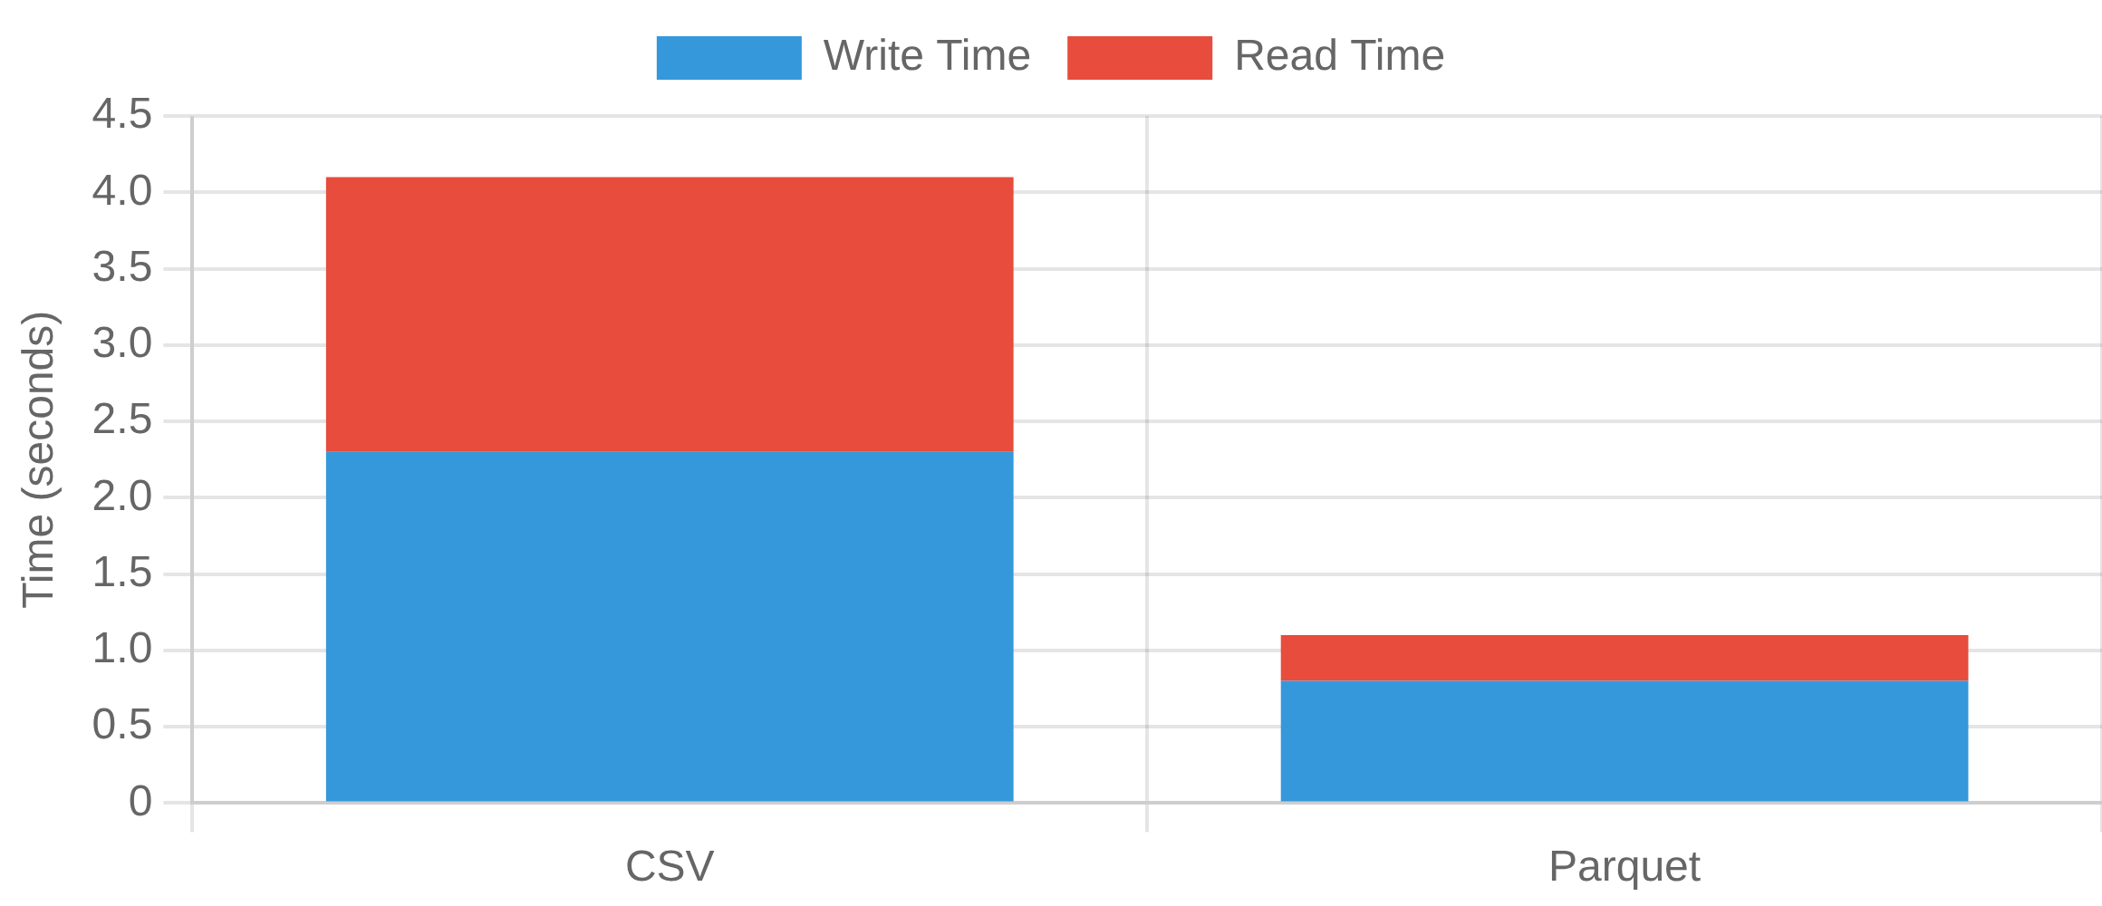
Live Demo Results
1M rows benchmark results
File Size Comparison (MB)
Processing Time (seconds)
Format
File Size
Write Time
Read Time
Total Time
CSV
15 MB
2.3s
1.8s
4.1s
Parquet
4 MB
0.8s
0.3s
1.1s
🚀 Parquet is 73% smaller and 6x faster to read!

Slide 19
Apache Arrow – Why It Matters
Evolution: Apache Parquet → Apache Arrow
2013 – Apache Parquet (On-Disk Revolution)
Born from Twitter + Cloudera (later Apache project).
Solved: Efficient columnar storage for Hadoop/Spark.
Features:
Columnar compression (Snappy, Gzip, ZSTD).
Predicate pushdown (scan only needed columns).
Schema stored with data.
Became the de facto file format for data lakes.
2016 – Apache Arrow (In-Memory Revolution)
Developed as evolution of columnar ideas from Parquet.
Solved: Inefficiency in moving data between systems (Pandas, R, Spark, DBs).
Features:
Standardized in-memory format (columnar buffers).
Zero-copy data sharing across languages (Python, R, Java, Rust, Go, Julia).
Compatible with Parquet schema → fast read/write.
Became the universal in-memory layer for analytics.

Slide 20
Apache Arrow – Big picture
What is Apache Arrow?
Key Points:
Open-source cross-language platform for in-memory analytics.
Defines a standardized columnar memory format (not just a file format).
Created to solve inefficiency in moving tabular data between systems.
Backed by Apache Software Foundation with contributions from many companies.
Features:
Columnar data layout → efficient vectorized computation (SIMD).
Zero-copy reads → share memory across processes without serialization.
Cross-language interoperability → C, C++, Java, Python (PyArrow), R, Go, Rust, Julia.
Schema-aware → data types, nullability, metadata stored with the data.
Foundation for formats → Feather (Arrow IPC), Parquet integration, Pandas Arrow backend.
Analogy: 👉 Arrow is like a universal power plug for data — instead of using adapters (serialization), every tool connects directly to the same socket.

Slide 21
Apache Arrow – Why It Matters
Performance Advantages:
Speed: Cache-friendly, vectorized operations on columns.
Memory efficiency: Compact columnar buffers vs. scattered Python objects.
No serialization overhead: Direct zero-copy between tools.
Use Cases:
Pandas 2.0: Arrow-backed dtypes (string[pyarrow], int64[pyarrow]).
Spark ↔ Pandas: UDFs use Arrow for fast data transfer.
DuckDB: Query Arrow tables without conversion.
Machine Learning: Arrow speeds up data handoff to PyTorch / TensorFlow.
Storage Formats:
Feather = Arrow IPC on disk (fast exchange).
Parquet integrates with Arrow for schema alignment.
Ecosystem Impact:
Arrow is the de facto standard for in-memory tabular data.
Supported by: Pandas, Spark, Dask, Ray, Polars, Snowflake, BigQuery, AWS Athena, etc.
Acts as the data interchange layer in modern data lakes & ML pipelines.

